Slide 1
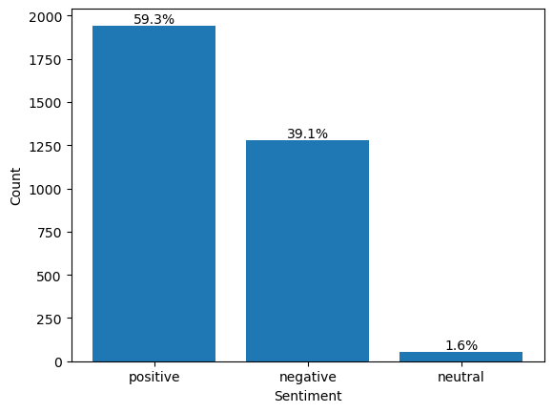
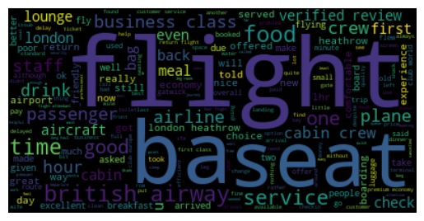
RESULT
SENTIMENT DISTRIBUTION PLOT:
This plot from over3000 verified trips by British Airways customers classifies customer sentiment as follows:
59.3% Positive Sentiment
39.1% Negative Sentiment
1.6% Neutral Sentiment
Source: https://www.airlinequality.com/airline-reviews/british-airways

